Slide 1


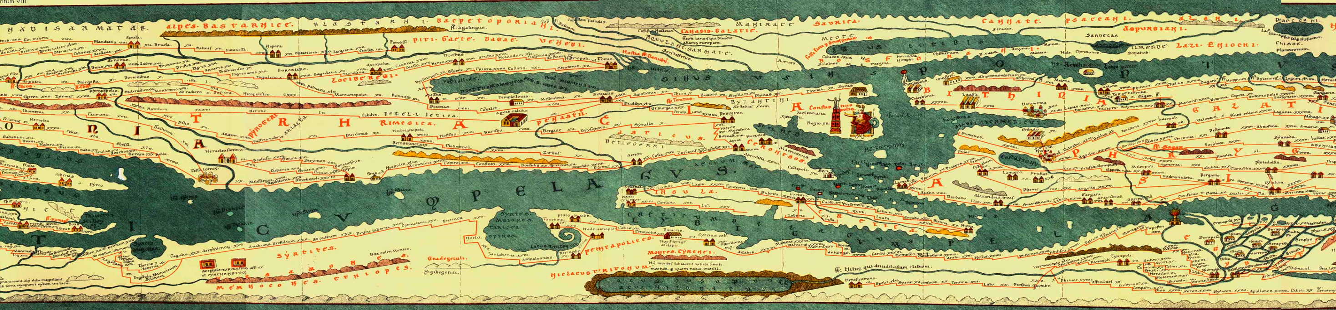
With the support of the Erasmus+ programme of the European Union. This document and its contents reflects the views only of the authors, and the Commission cannot be held responsible for any use which may be made of the information contained therein.
History and development role
of Roman Routes
Culture

Slide 2


Objectives and goals
At the end of this module you will know:
• the main European Roman routes
• the basic history of the European Roman routes
• the development of the European Roman routes
  the role of the European Roman routes during the Roman Empire

Slide 3
Roman engineering
“The extraordinary greatness of the Roman Empire manifests itself above all in three things:
the aqueducts,
the paved roads, and the construction of the drains.”
Dionysius of Halicarnassus,
Roman Antiquities, 3.67.5

Slide 4
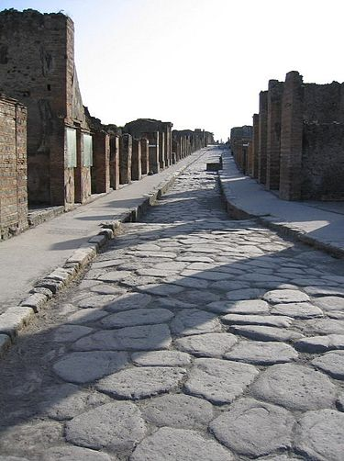
Types of Roman roads
Viae publicae: connect important cities, like todays highways
Viae vicinales: local roads connecting small settlements or villages (“vici”)
Viae privatae: private or country roads

Slide 5
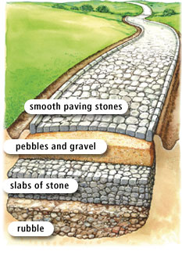
Construction of Roman roads
Constructed in layers
to withstand floods
and environmental hazards
Road widths from 1m
to more than 7m
They were built
as straight as possible!

Slide 6
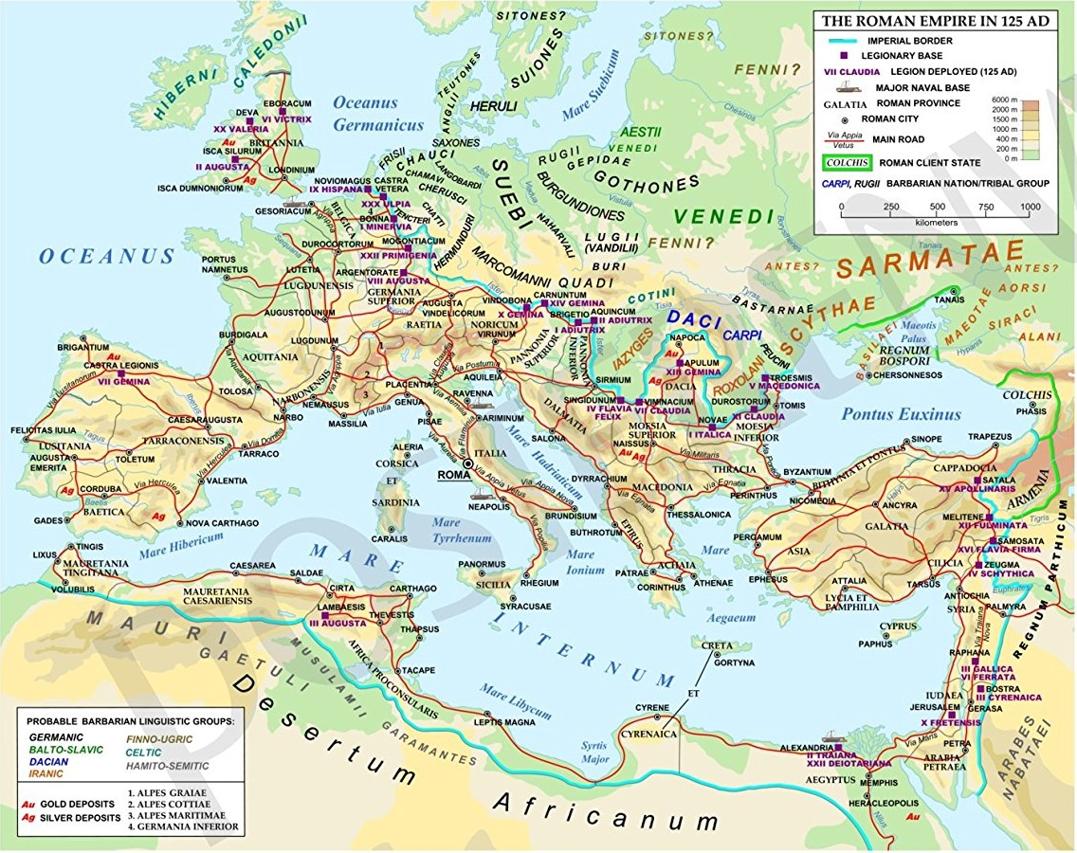
Roman roads in Europe
The network
spread across the Empire.
….
From Britain to Syria!
Via Appia :
first and most famous great Roman road!

Slide 7
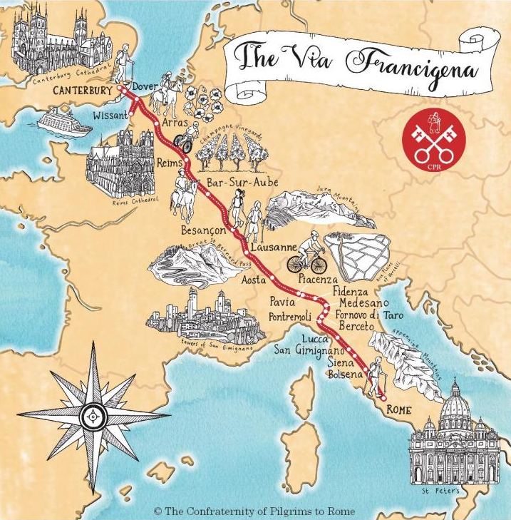
A Special Case: Via Francigena
“The road that comes from France”
Important medieval pilgrim route
of 2000Km from Canterbury (England) to Rome.
Passes through England, France, Switzerland and Italy.
Pilgrims reached Apulia and sailed to
the Holy Land.
image source: https://pilgrimstorome.org.uk/the-via-francigena/

Slide 8
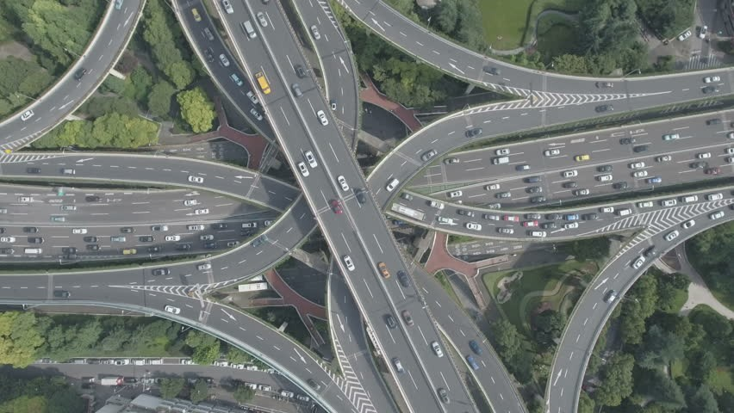
Role of road networks
economic activity
connectivity
1. reduced information frictions
2. increased cultural integration

Slide 9
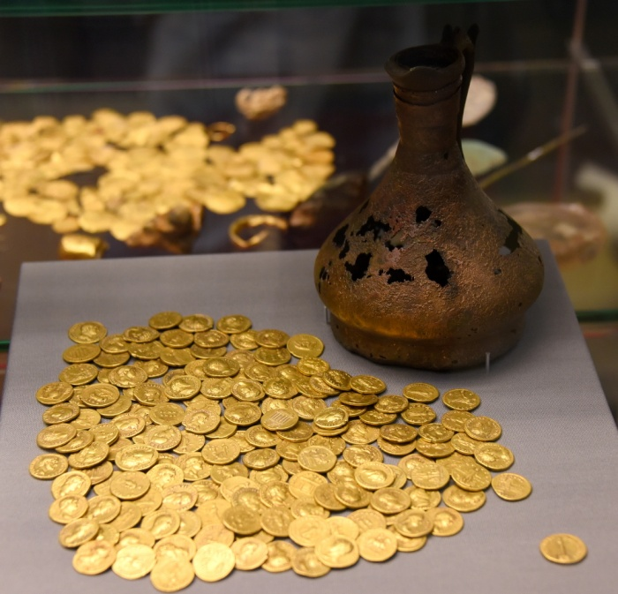
Role of Roman roads network
Specialization of manufactured products
Exchange of various goods
Assimilation of
preferences, values, attitudes
Food security
Interpersonal interaction
Migration
Technological & cultural diffusion
Image by Osama Shukir Muhammed Amin (CC BY-NC-SA)

Slide 10
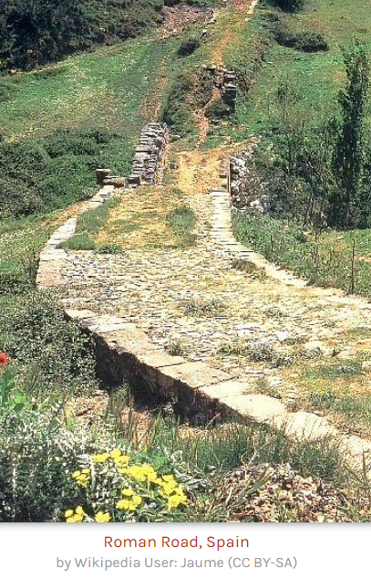
The Roman roads in Middle Ages
No technological development for Roman roads!
Why?
the organization of people in small states (feudalism);
the life threatening diseases, calamities, wars;
mobility of people was judged unnecessary and potentially harmful.
Exceptional case was the Varangian Route
(its main part was water road)

Slide 11
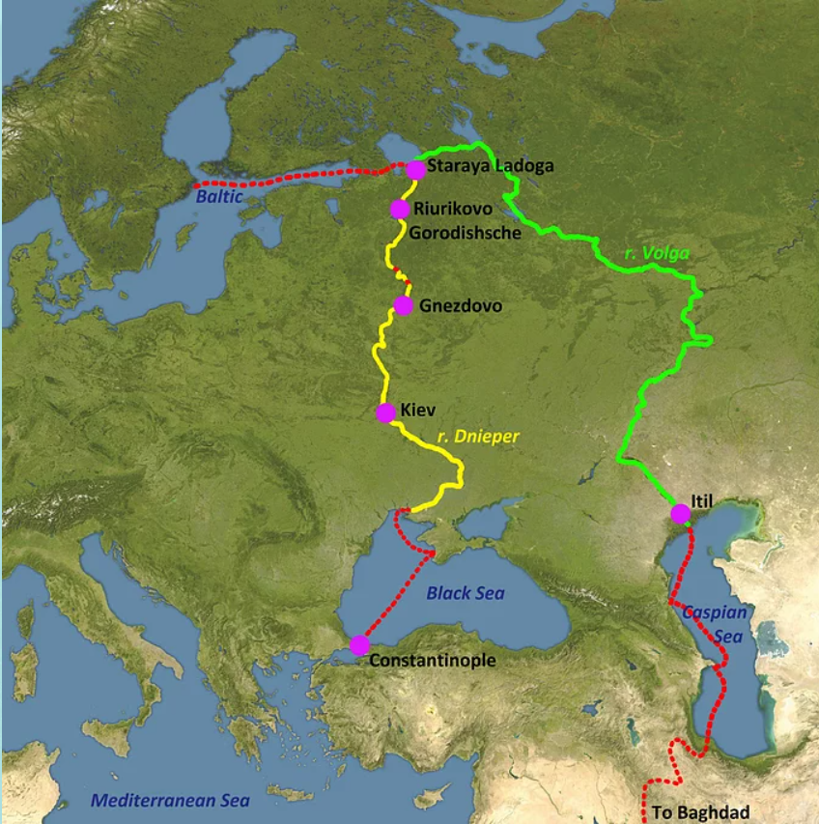
The Varangian route
Medieval trade water route
across river Dnieper.
Connected Scandinavia,
Kievan Rus' and the Eastern Roman Empire and Constantinople.
The Varangian route
(yellow line on the map)
image source: https://www.asncvikingage.com/vikings-east

Slide 12
Thank you for your attention !
With the support of the Erasmus+ programme of the European Union. This document and its contents reflects the views only of the authors, and the Commission cannot be held responsible for any use which may be made of the information contained therein.

